Slide 1
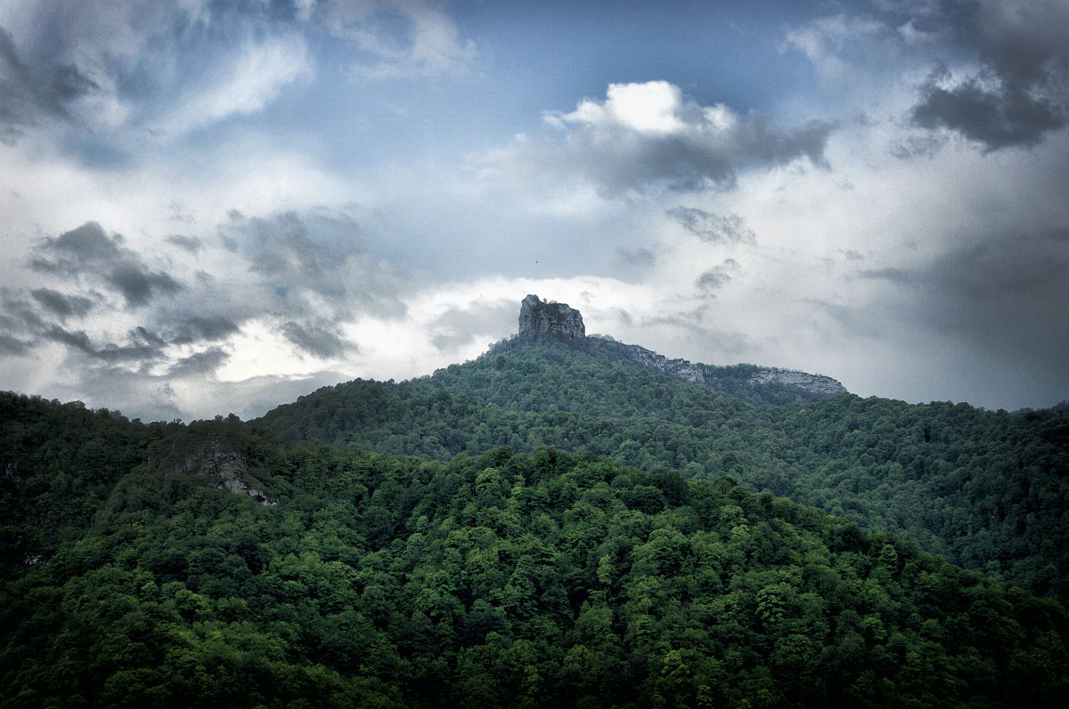
Fizuli Presentation
By Janpolad

Slide 2

Fizuli
Fizuli was founded in 1827.
The province had substantial
economical and historical value
for Azerbaijan.

Slide 3

Essential discussed topic.
Second in value, but also essential to mention in presentation.
Objects, types of activities landmarks mentioned in presentation.

Slide 4
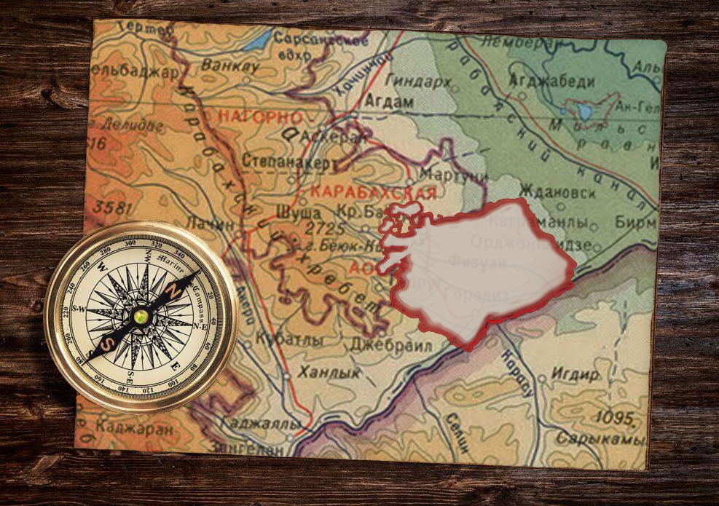
Fizuli
The Fizuli area covers the gentle plains and lowlands from the south-eastern foothills of the Kara-Bah mountains to the Araz River.

Slide 5
Fizuli
The Fizuli area covers the gentle plains and lowlands from the south-eastern foothills of the Kara-Bah mountains to the Araz River.

Slide 6
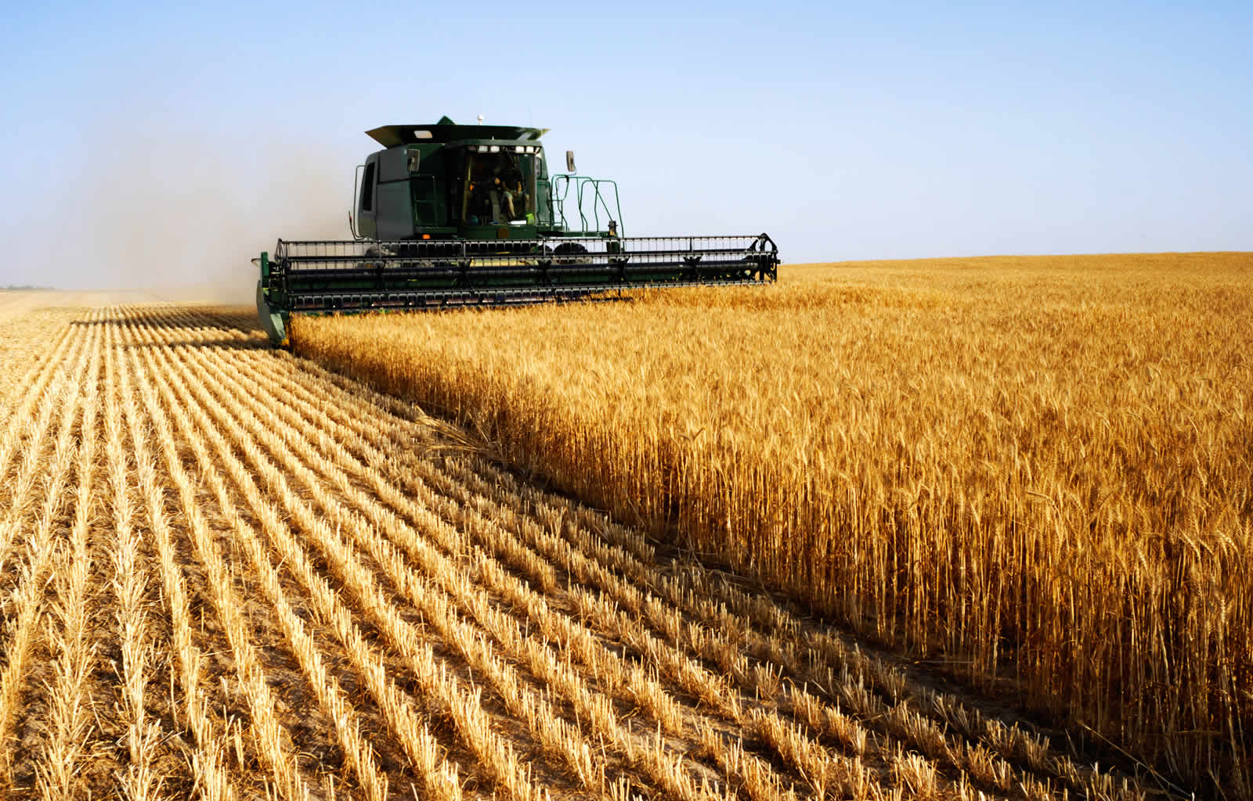

Slide 7
Agriculture was backbone
of the the Fizuli economy.
Before the occupation, wheat crops, livestock, viticulture, sheep, poultry
and silkworm farming were widely developed in the area.

Slide 8
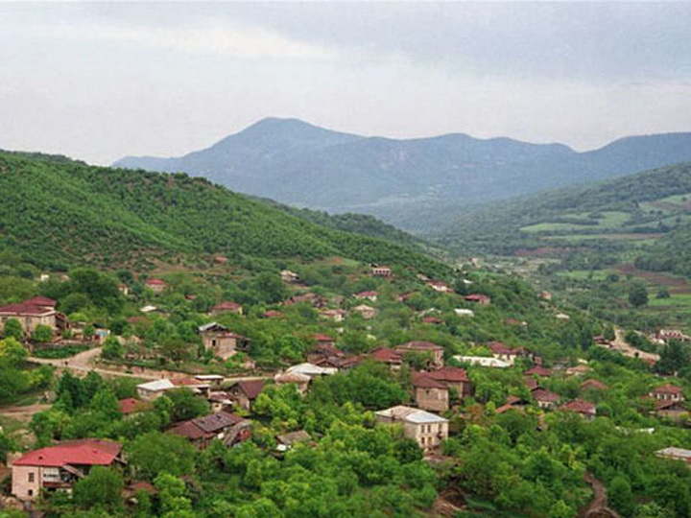
В неотстающим от других районов по развитию культуры Физулинском районе, до оккупации действовали 90 библиотек, 20 домов культуры, 79 клубов, 20 киноустановок, 2 музея, народный и государственный драматические театры, парки отдыха.

Slide 9
Before the occupation, 90 libraries, 20 cultural centres, 79 clubs, 20 cinema units, 2 museums, a folk theatre and a state drama theatre, recreation parks were operating in Fizuli district, which was not behind other districts in its cultural development.
In the field of education and medicine there were 13 hospitals with 685 beds, 17 medical centres, 30 medical and obstetric stations, a tuberculosis clinic, a dermatovenerology clinic, a technical school, 86 secondary schools, 2 vocational schools, 65 pre-schools, a stadium and other facilities.

Slide 10
In the field of education and medicine there were 13 hospitals with 685 beds, 17 medical centres, 30 medical and obstetric stations, a tuberculosis clinic, a dermatovenerology clinic, a technical school, 86 secondary schools, 2 vocational schools, 65 pre-schools, a stadium and other facilities.
Before the occupation, 90 libraries, 20 cultural centres, 79 clubs, 20 cinema units, 2 museums, a folk theatre and a state drama theatre, recreation parks were operating in Fizuli district, which was not behind other districts in its cultural development.

Slide 11

Fuzuli district In April 1959, on the 400th anniversary of the birth of great poet Mohammed Fuzuli, the old name of the district of Garyagin was changed to Fuzuli district.

Slide 12
Fuzuli district In April 1959, on the 400th anniversary of the birth of great poet Mohammed Fuzuli, the old name of the district of Garyagin was changed to Fuzuli district.

Slide 13
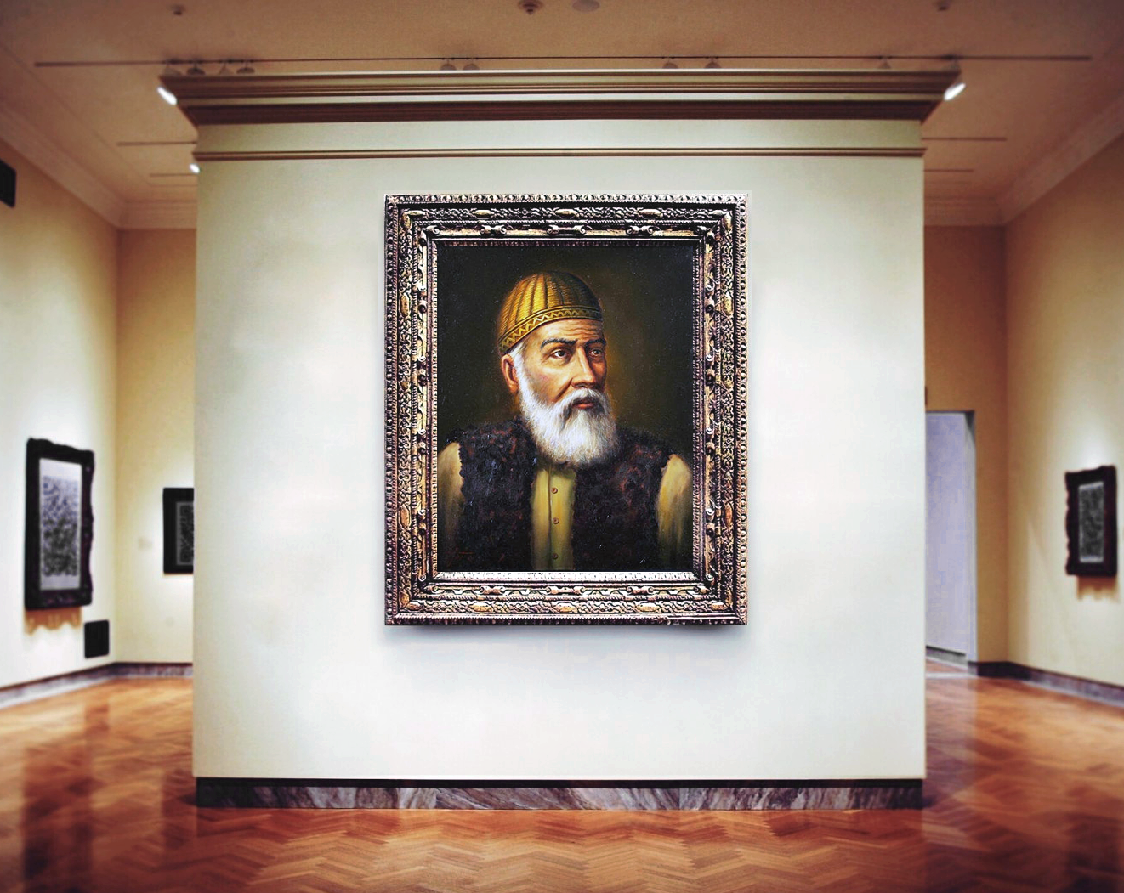
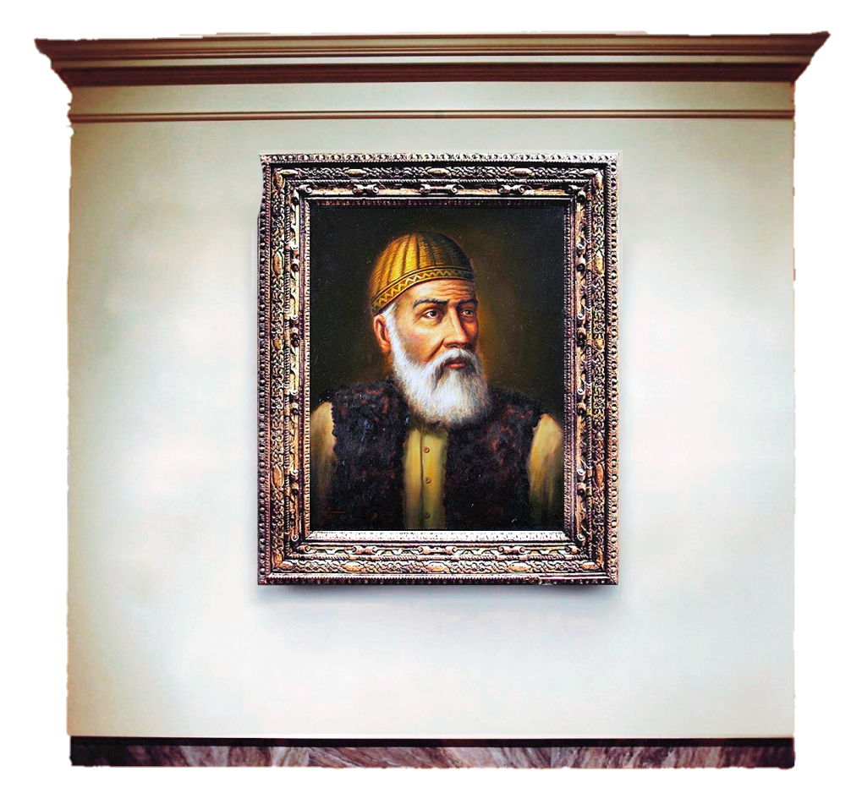

Interesting facts
Biography of Mohammed Fizuli Suleiman Ogly further on.
Мухаммед Физули
Выдающийся азербайджанский поэт, мыслитель и переводчик XVI века, чьи талантливые работы зани-мают второе место в истории Аз-на после Низами.

Slide 14
Mohammed Fizuli
An outstanding Azerbaijani poet, thinker and translator of the 16th century, whose talented works rank second in the history of Azerbaijan after Nizami.
Это интересно!
Биография Мухаммеда Физули Сулейман Оглы далее.

Slide 15
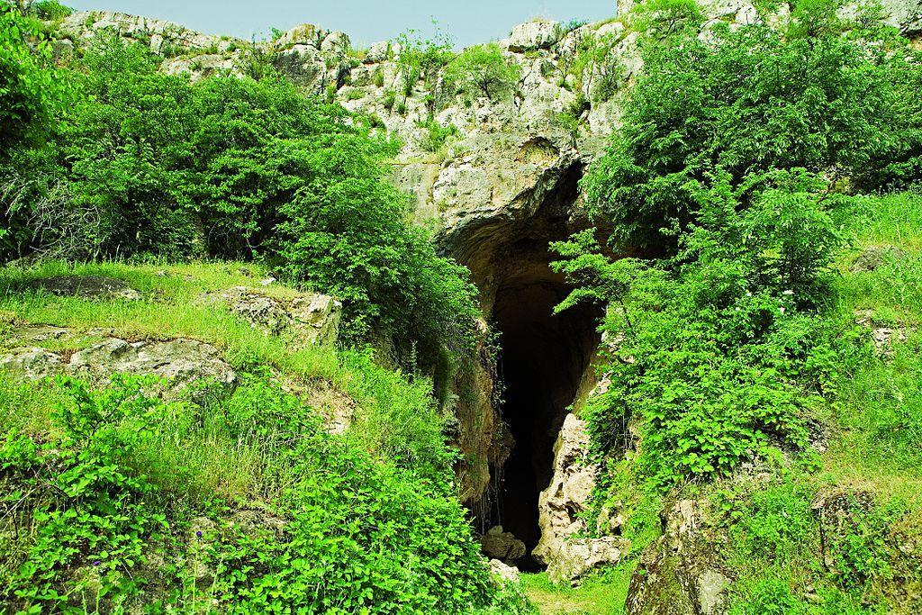
Interesting Facts
Facts about the Azykh Cave further on.
Fuzuli district is also famous for the Azykh Cave, Guruchay culture, historical and architectural monuments, which are thousands of years old.

Slide 16
Fuzuli district is also famous for the Azykh Cave, Guruchay culture, historical and architectural monuments, which are thousands of years old.
Это интересно!
Факты о Азыхской пещере далее.

Slide 17
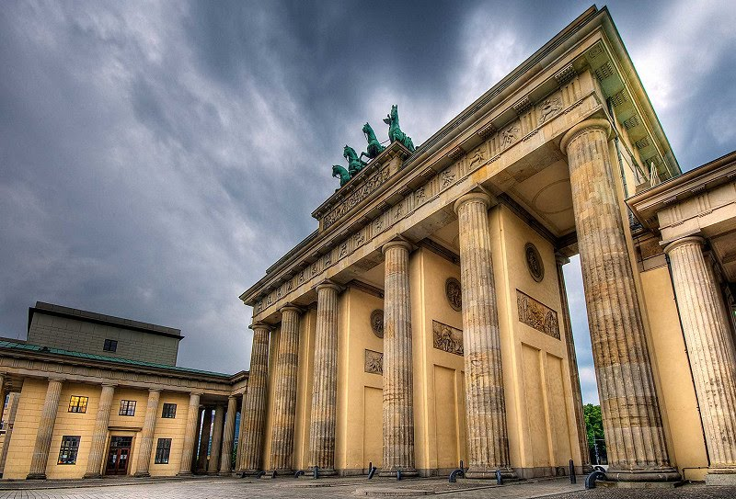
Fizuli was also known for its strong human resource potential, highly intelligent intellectuals and eminent scientists. The commitment to honest work for the benefit of society was the way and meaning of life of the Fizuli people.

Slide 18
Fizuli was also known for its strong human resource potential, highly intelligent intellectuals and eminent scientists. The commitment to honest work for the benefit of society was the way and meaning of life of the Fizuli people.

Slide 19

On 17 October 2020, the town of Fizuli, as well as 53 villages of the district were liberated from Armenian occupation during the second Karabakh war. Azerbaijani sovereignty was established over Fizuli district and the territorial integrity of the Republic of Azerbaijan was restored.

Slide 20

Interesting facts
More facts about the Fizuli district.
More than 300 candidates and doctors of science come from Fizuli district.

Slide 21
More than 300 candidates and doctors of science come from Fizuli district.
Это интересно!
Дополнительные факты о Физулинском районе.

